Slide 1

Chapter 11
Advanced Templating and
Class-Based Views

Slide 2

Objectives
You will also write class-based views that will help you perform CRUD operations.
You will have a clear understanding of how Django handles advanced templating and how you can build custom views that support CRUD-based operations.

Slide 3
Django Views

Slide 4
Django Views
Function-Based Views (FBVs): FBVs inside Django are nothing more than generic Python functions that are supposed to take an HTTPRequest type object as their first positional parameter and return an HTTPResponse type object.

Slide 5
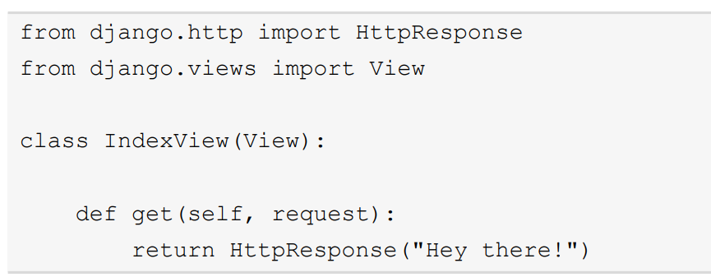
Django Views
Class-Based Views (CBVs): CBVs are views that closely adhere to the Python object-oriented principles and allow mapping of the view calls in a class-based representation.

Slide 6
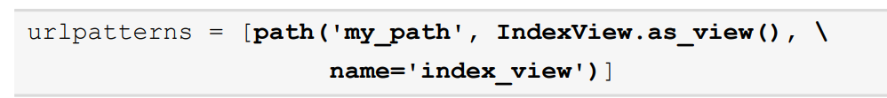
Django Views
For example, let's say we wanted to map IndexView to a URL endpoint in our application. In this case, all we need to do is to add the following line to our urlpatterns list inside the urls.py file of the application.

Slide 7
Django Views
View: The base class for all CBVs available in Django that allows a custom CBV to be written with all the features provided and overridable. A user can implement their own definitions for different HTTP Request methods, such as GET, POST, PUT, and DELETE.

Slide 8
Django Views
TemplateView: A view that can be used to render a template based on the parameters for the template data provided in the URL of the call.

Slide 9
Django Views
RedirectView: A view that can be used to automatically redirect a user to the correct resource based on the request they have made.

Slide 10
Django Views
DetailView: A view that is mapped to a Django model and can be used to render the data obtained from the model using a template of choice.

Slide 11
CRUD Operations with CBVs

Slide 12
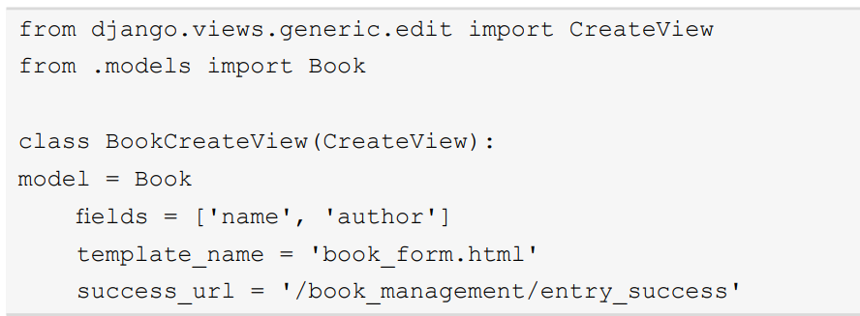
Create View
To build a view that helps in object creation, we'll need to open the view.py file under the book_management directory and add the following lines of code to it:

Slide 13
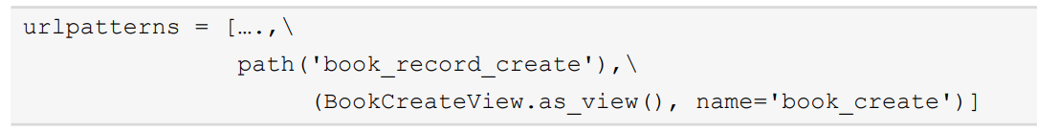
Create View
With this, we have created our CreateView for the book resource. Before we can use it, we will need to map it to a URL.

Slide 14
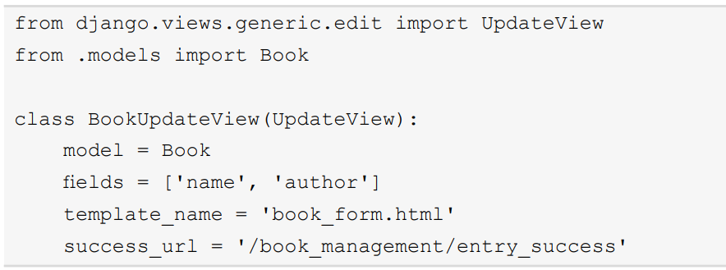
Update View
In this view, we want to update the data for a given record.

Slide 15
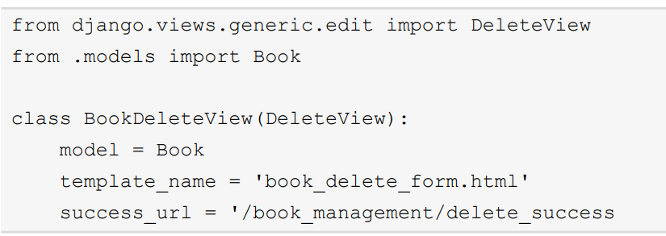
Delete View
Delete view, as the name suggests, is a view that deletes the record from our database.

Slide 16
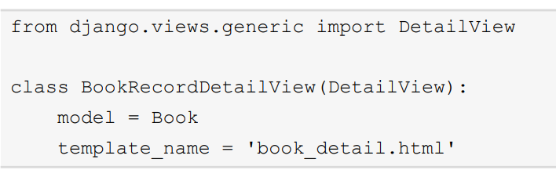
Read View
In this view, we would like to see a list of records that our database stores for the books.

Slide 17
Summary
In this chapter, we learned about the advanced templating concepts in Django.
Understood how we can create custom template tags and filters to fit a myriad of use cases and support the reusability of components across the application.
We then looked at how Django provides us with the flexibility to implement FBVs and CBVs to render our responses.

